Slide 1







Physics-Guided Discovery of Highly Nonlinear Parametric Partial Differential Equations
Presenter: Yingtao Luo (PhD student at Carnegie Mellon University)
Authors: Yingtao Luo, Qiang Liu, Yuntian Chen, Wenbo Hu, Tian Tian, Jun Zhu
Notes:
Hi, everyone. My name is Yingtao and I am very happy to present our paper “Physics-Guided Discovery of Highly Nonlinear Parametric Partial Differential Equations”.

Slide 2
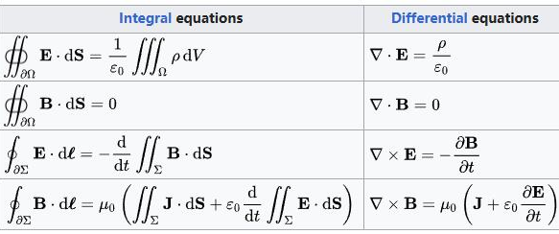




Partial Differential Equations (PDEs) are Ubiquitous
Maxwell’s Equations (Electromagnetism)
Convection–Diffusion Equation
Black-Scholes PDE (Finance)
Navier-Stokers Equation (Fluids)
Schrödinger Equation (Quantum)
Notes:
We know that partial differential equation is an important pillar of modern science. How to discover these PDEs to explain complex phenomena is of great interest to the science community.

Slide 3
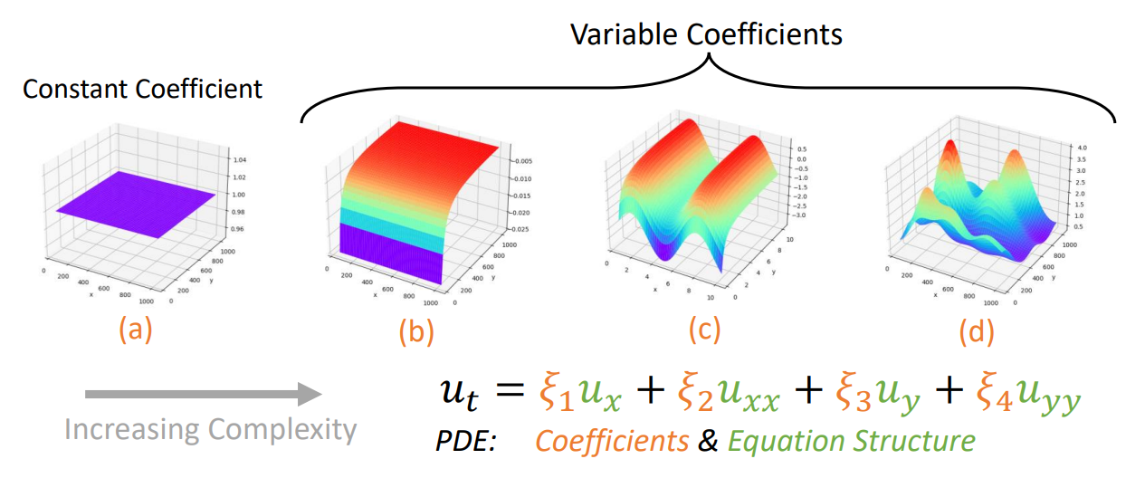
PDEs with Variable Coefficients
(a) a constant value 1, (b) −1/𝑥, (c) −1/𝑥 + sin𝑦, (d) complex coefficient field
Notes:
Currently, there are some baselines to deal with PDEs with variable coefficients. However, there lacks research on the discovery of PDEs with highly nonlinear coefficients, which are very common in complex systems and fluid dynamics.

Slide 4
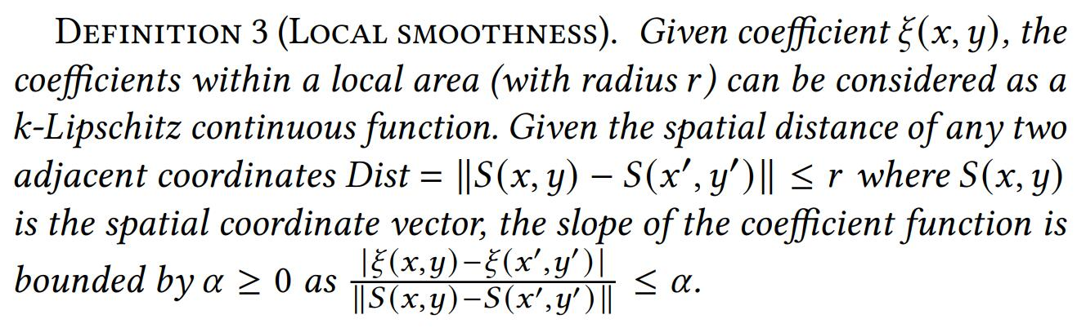
Motivation 1: Smooth Coefficient Field
Recall: Differentiation accuracy assumes smoothness as a first principle.
Notes:
We introduce some physical principles and knowledge as constraints to guide the optimization. First, we assume the smoothness of physical fields.

Slide 5
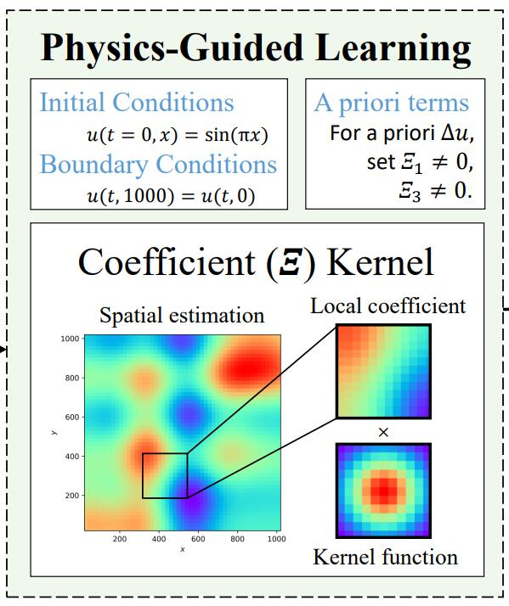
Motivation 2: Physics Knowledge & Principles
Physics Knowledge:
Initial and boundary conditions, a priori terms.
Physics Principles:
1. Conservation laws: spatiotemporally rotation and translation invariant.
2. Smoothness constraint.
Notes:
Considering the conservation laws, we propose a spatial kernel in the regression process, that is invariant to spatiotemporal rotation and translation.

Slide 6
Complexity and Theoretical Analysis
Kernel Complexity: Linearly proportional to the size of the dataset.
Estimation Error: Strictly lower than works like Adaptive-DLGA [1].
Robustness: Strictly lower than independent coefficient estimation.
Mesh-Free: (Kernel only calculates spatial distance. No grid is needed.)
[1] Hao Xu, et al. 2021. Deep-learning of parametric partial differential equations from sparse and noisy data.
Notes:
Our method has a linear complexity, much more efficient compared to other potential approaches. We demonstrate that the estimation error is strictly lower than previous works. We also theoretically demonstrate that our model is more robust against noise. Our model is continuous over spacetime without the need of grids.

Slide 7
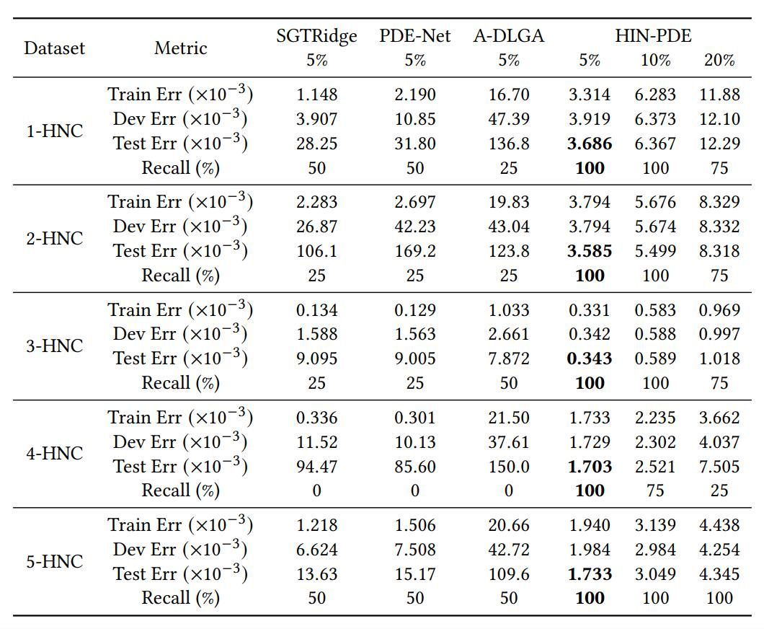

On variable coefficients
Governing equation of underground seepage with HIN coefficients
The only method that discovers the equations correctly!
Notes:
We consider the governing equations of underground seepage. Our method is the only one that discovers the highly nonlinear PDE terms correctly with small errors on both the coefficient estimation and the sparse regression target.

Slide 8
A question for everyone: How many constraints are enough?
Uniqueness of the PDE
Generalization Ability
More Physics Knowledge
More Physics Principles
Higher Complexity of Problem
Lower Data Quality Requirement
Can we meet the excessive growing expectation?
Notes:
To think about the future, we know that more physics constraints are good, but can we find enough domain knowledge to meet the excessive growth of the complexity of the scientific problems? Can we also do more about the data side instead of the model side, and can we create a human-in-the-loop paradigm to further push forward of the boundaries of problems we can solve? There are still a lot of complex phenomena in nature that people do not fully understand and that leaves us with a lot of opportunities.

